Slide 1
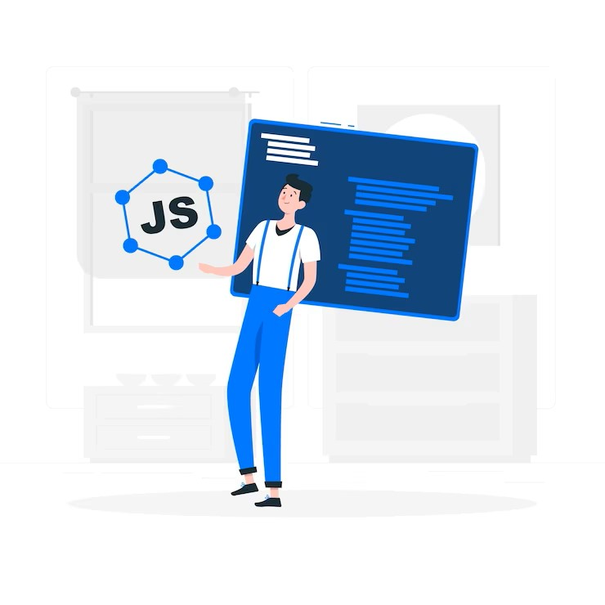

JAVASCRIPT
JAVASCRIPT BASICS

Slide 2
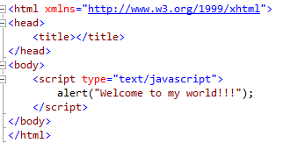
JavaScript Syntax
JavaScript consists of JavaScript statements that are placed within the <script>…</script>
<script> type="text/javascript"> and </script> tell where JavaScript starts and ends.

Slide 3


JavaScript Data Types
All numbers in JavaScript are represented as floating-point values.
JavaScript does not make a distinction between integer values and floating-point values.

Slide 4

JavaScript Variables
Variables can be thought of as named containers.
Place data into these containers and then refer to the data simply by naming the container.
Before using a variable in a JavaScript program, must declare it.
Variables are declared with the var keyword

Slide 5
Conditional Statements
JavaScript supports conditional statements which are used to perform different actions based on different conditions.
JavaScript supports the following forms of if-else statements:
Use if to specify a block of code to be executed, if a specified condition is true
Use else to specify a block of code to be executed, if the same condition is false
Use else if to specify a new condition to test, if the first condition is false
Use switch to specify many alternative blocks of code to be executed

Slide 6
JavaScript Events
JavaScript's interaction with HTML is handled through events
Events are actions.
A few examples of events:
A mouse click
The webpage loading
Mousing over a hot spot on the webpage, also known as hovering
Selecting an input box in an HTML form
A keystroke

Slide 7
JavaScript Functions
A function is a group of reusable code which can be called anywhere in the program.
Divide a big program into a number of small and manageable functions.
Before using a function we need to define that function.
Define a function in JavaScript by using the function keyword

Slide 8

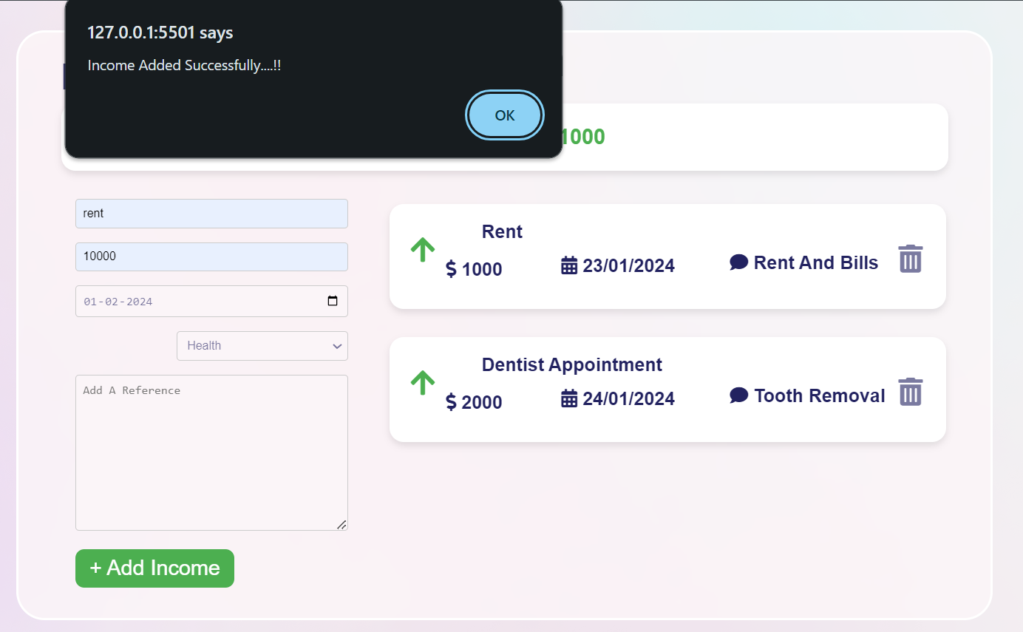
The alert() method displays an alert box with a message and an OK button.
The alert() method is used when you want information to come through to the user.

Slide 9
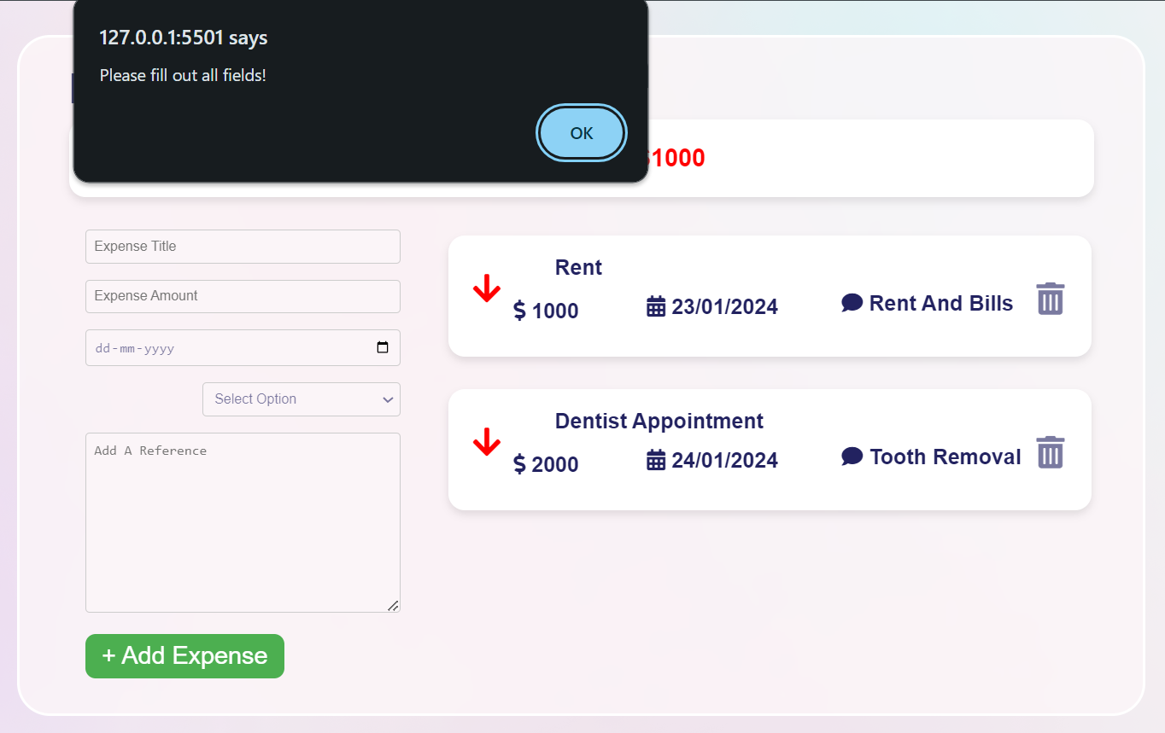
JavaScript provides facility to validate the form on the client-side so data processing will be faster than server-side validation.

Slide 10


